Slide 1
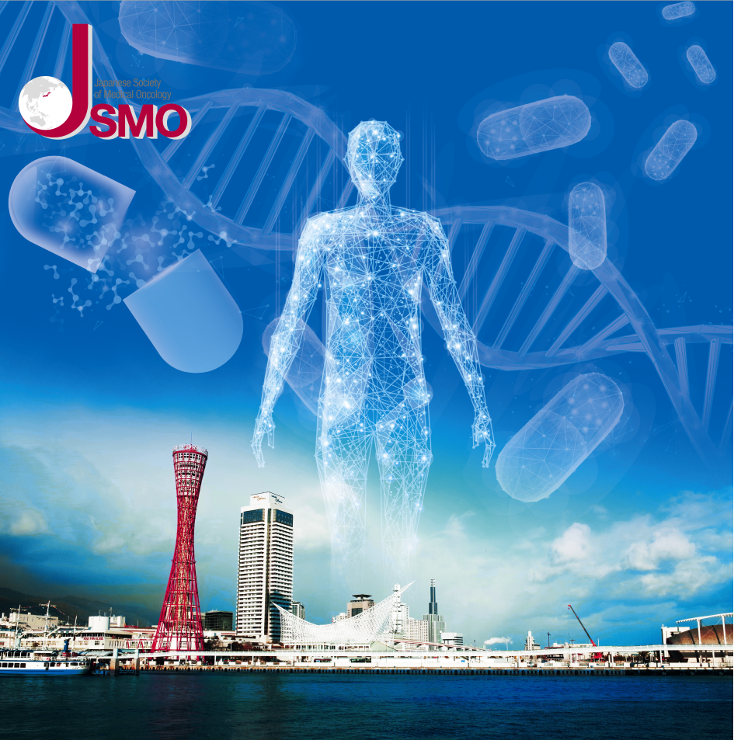
演題募集締切
9月17日（火）正午
参加登録開始
11月（予定）

Slide 2
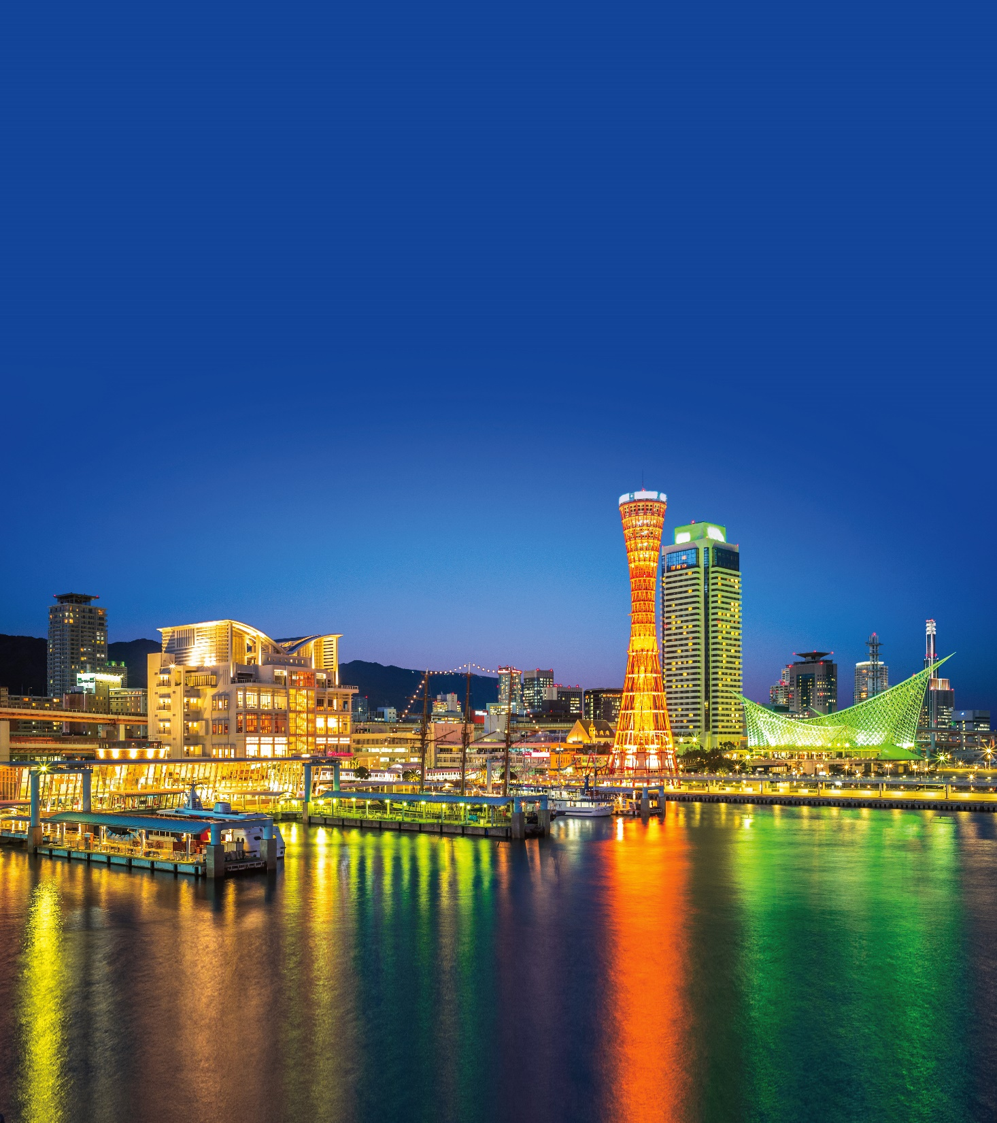
Call for Abstract Deadline
Noon, September 17
Registration Open
November
(TBC)

Slide 3
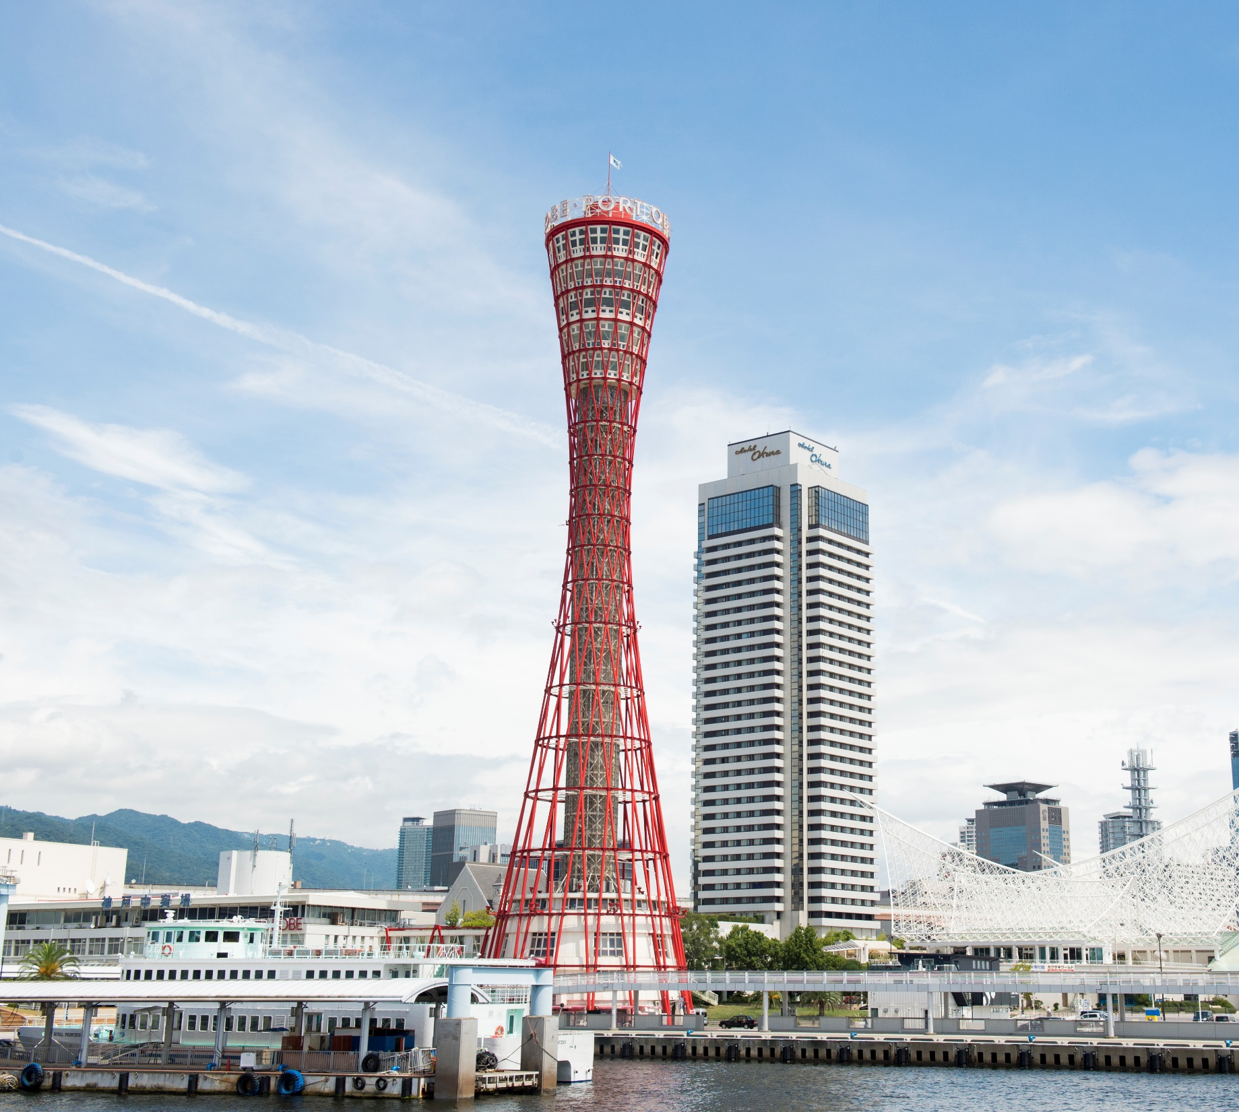
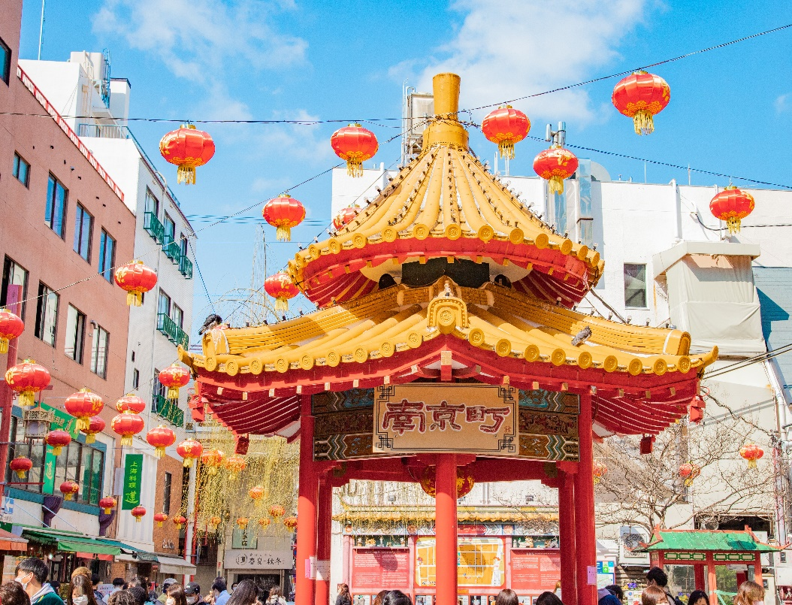
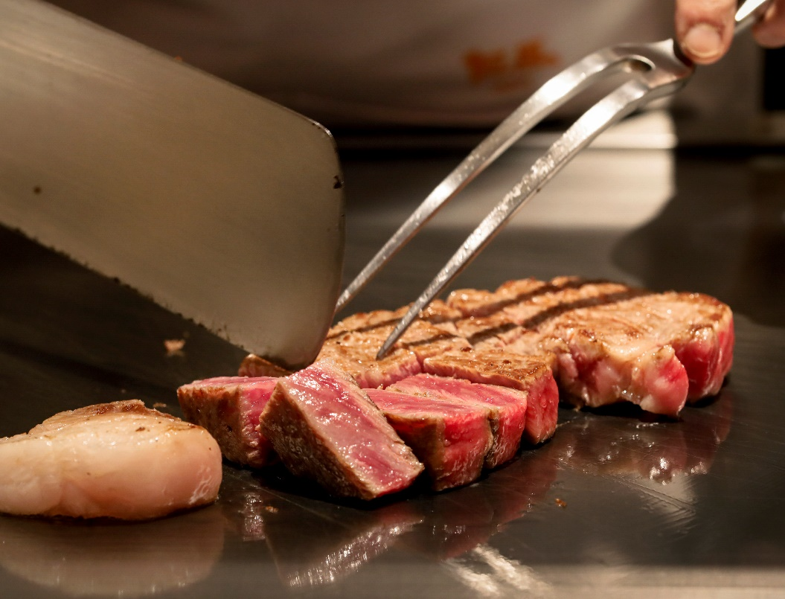
Kobe,
the city of
Beautiful Port & Landscape,
Great Culture,
and
Kobe Beef

Slide 4
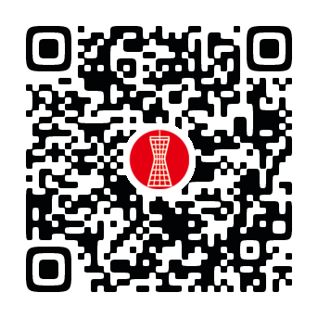
Scan the code to learn more about JSMO 2025!

